Slide 1
DL Algorithm Using MRM data
최정인

Slide 2
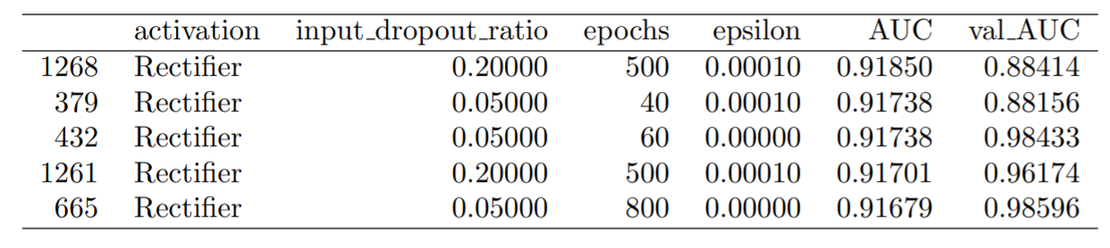
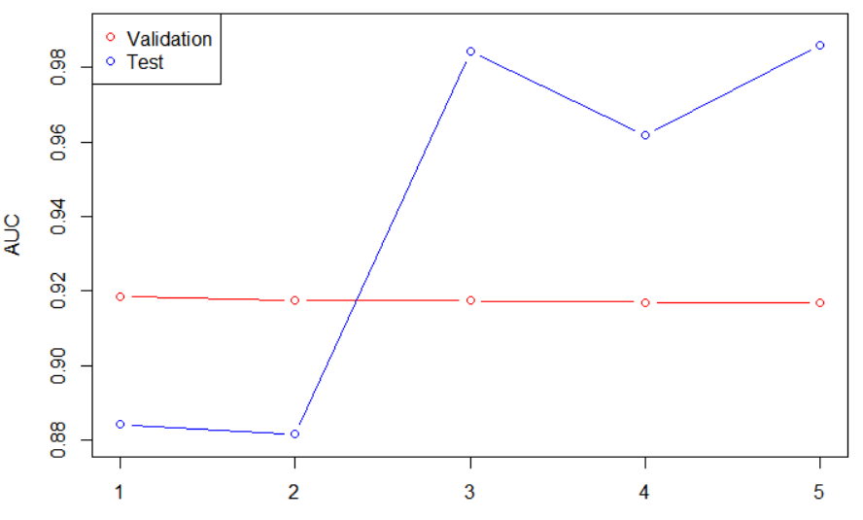
Previous test AUC of Best 5 models (using 33 biomarkers)
test

Slide 3
Experimental Design (70 biomarkers, n=1008)
Validation
Train
n=807
Dataset
n=1008
Test
10-fold CV
Hyperparameter Optimization
n=201
Stratified 8:2

Slide 4
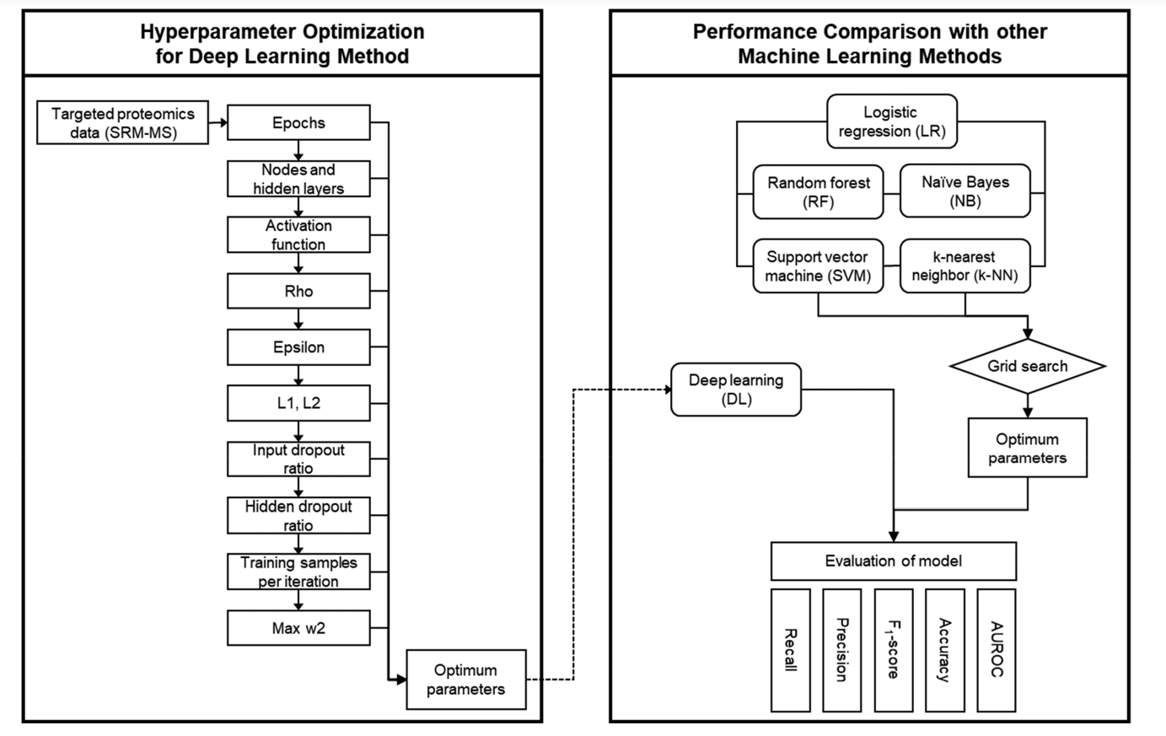
Experimental Design

Slide 5
Hyperparameter Tuning : 10-fold CV
Activation function : Rectifier / Tanh / Maxout
Input dropout ratio : 0 / 0.05 / 0.1 / 0.2
Epochs : 20 /30 /40 /50 /60 /70 /80 /90 /100 /200 / 300 / 400 / 500 / 600 / 700 / 800
Epsilon : 1e-4 /1e-5 /1e-6 / 1e-7 / 1e-8 / 1e-9 / 1e-10
Train sample per iteration : 0 / -1 / -2
To specify one epoch, enter 0. To specify all available data, enter -1. To use the automatic values, enter -2
Notes:
2688

Slide 6
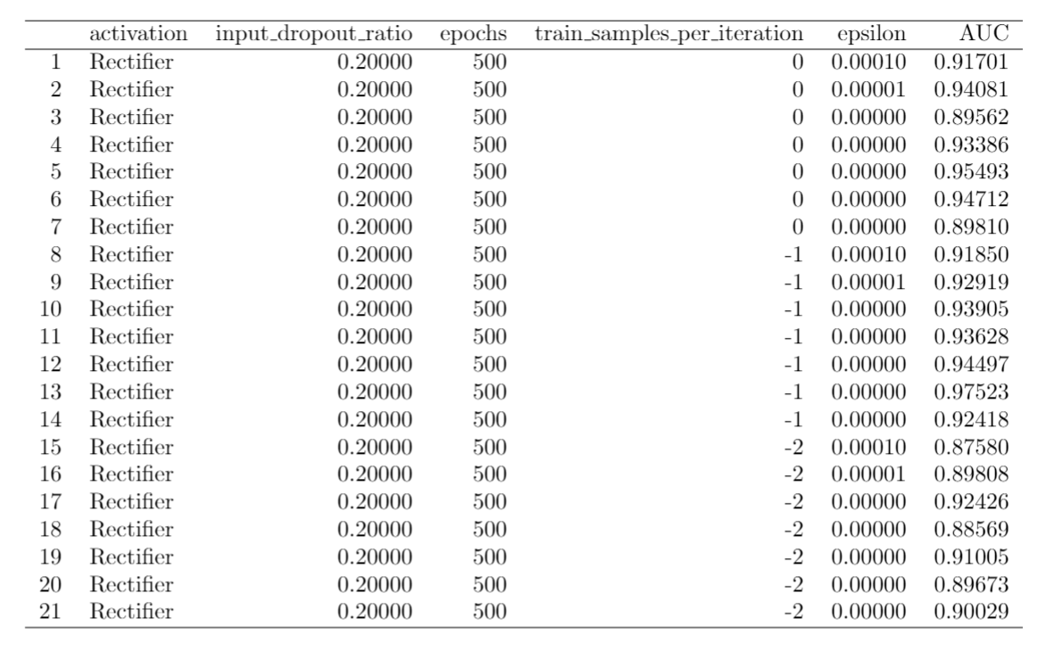
Grid Search : 10-fold CV AUC

Slide 7
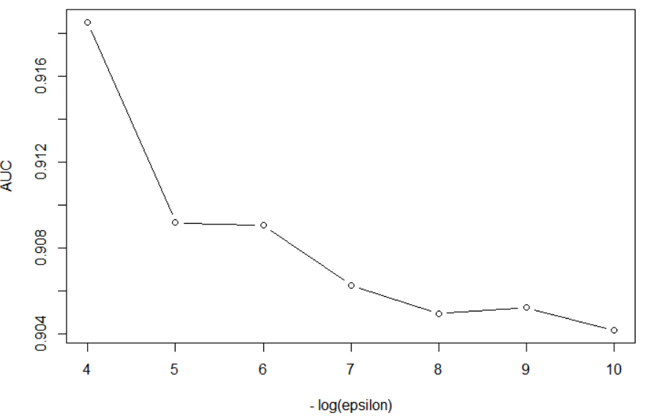
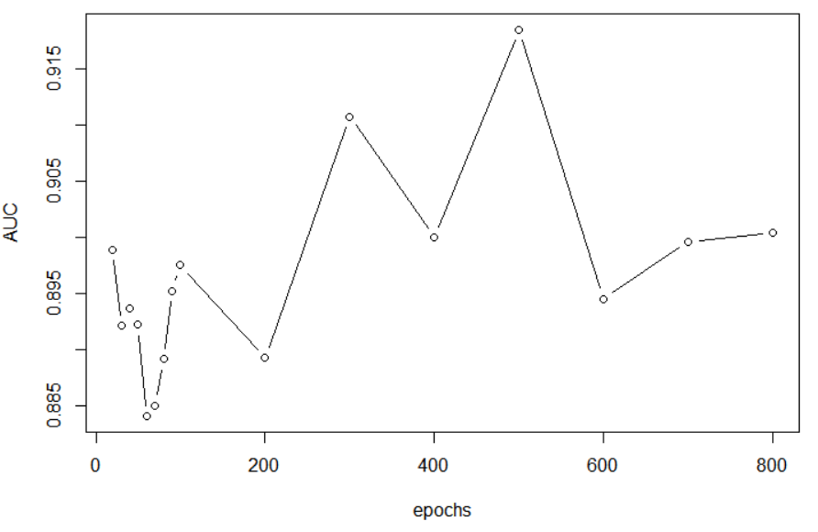
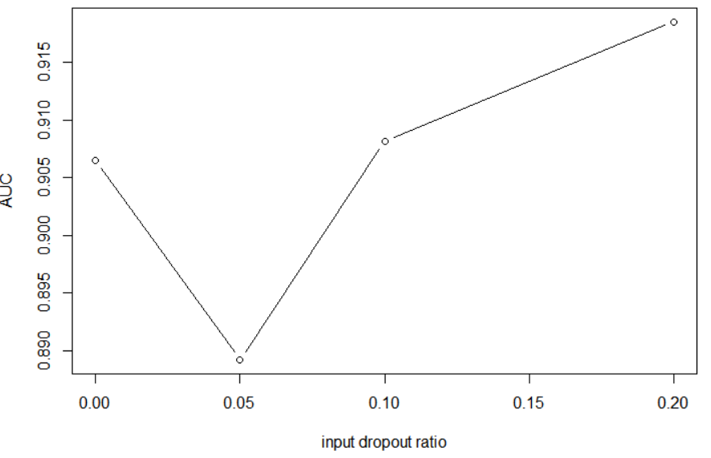
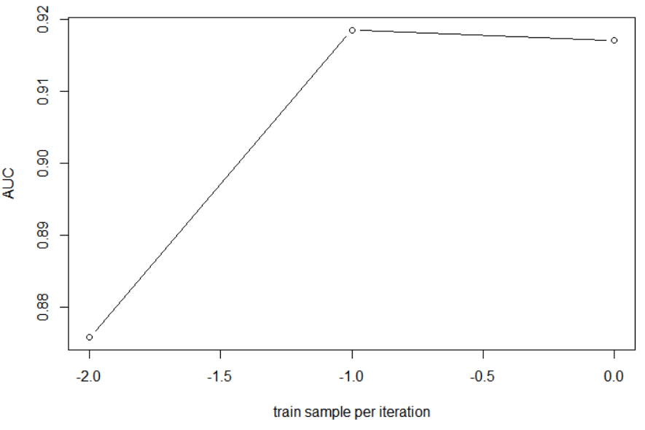
Train AUC – mean AUC of 10-fold CV

Slide 8
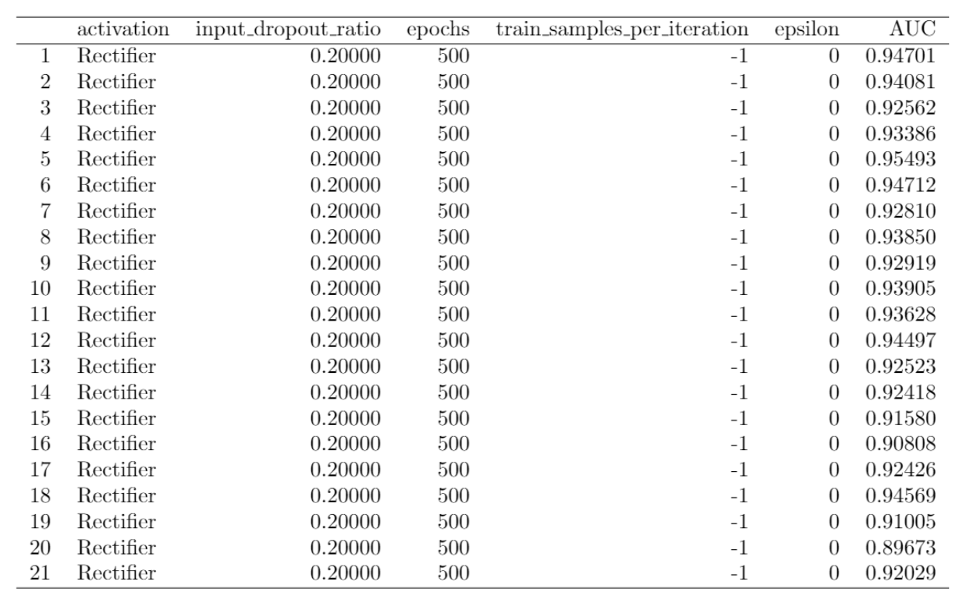
Test AUC for 100 stratified train/test set

Slide 9
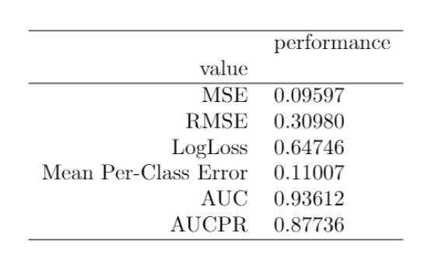
Test AUC for 100 stratified train/test set
** Metrics reported on full validation frame **

